Slide 1

Prior Authorization Support
Deep Dive
2025 HL7 Da Vinci Burden Reduction and Payor API Implementer Support
HL7 Da Vinci Training

Slide 2

About the Speaker
Technical Lead for the PAS Implementation Guide
HL7 Technical Steering Committee (TSC) Past Chair
HL7 Fellow
Co-Chair of HL7 Pharmacy, HL7 Biomedical Research & Regulatory, and HL7 Cross Group Projects Work Groups
25+ years of experience in software engineering and data architecture
Jean Duteau
Chief Technical Officer
Dogwood Health Consulting

Slide 3

This Presentation
Part of introductory training materials for the April 2025 Da Vinci Education Event
Can be downloaded here:
https://github.com/FHIR/documents/tree/master/presentations/2025-04-DaVinci
Is licensed for use under the Creative Commons, specifically:
Creative Commons Attribution 3.0 Unported License
(Do with it as you wish, so long as you give credit)

Slide 4


Pre-requisites & Post-requisites
Before taking this course, you should take:
Introduction to FHIR
How to read a FHIR IG
Coverage Requirements Discovery (CRD)
Documentation and Templates Rules (DTR)

Slide 5

Course Objectives
After completing this course, you should be able to:
Explain the purpose of the PAS operations
Understand the layout of the PAS Claim request, the PAS Claim Update request, the PAS Claim Response
Understand how Subscriptions are used with ‘pended’ PAS responses

Slide 6

Outline of Presentation
PAS Overview
What is PAS? • Primary objectives • Expected systems • Process flow
Submitting a Prior Authorization Request
PAS Claim Bundle • $submit operation • PAS Claim Response Bundle
Subscriptions for Pended Responses
Request for Additional Information
Interaction with CDex and DTR
PAS Inquiries
PAS Updates
Additional Considerations
Expectations for Conformance • Capturing metrics • Security expectations • PAS and ePA Coordination

Slide 7
PAS Overview
What is PAS?
Primary Objectives
Expected Systems
Process Flow Overview

Slide 8

What is PAS?
Patient
Prior Authoriation Support (Referred to as “PAS”).
Guide for enabling submission of prior authorization requests from EHR systems
Defines profiles on FHIR resources to enable submission.
Increases efficiency by ensuring that authorizations are always sent when and only when necessary.
Ensures requests will almost always contain all relevant information to make decision on initial submission.
A constituent Implementation Guide within Da Vinci Burden Reduction.

Slide 9


Primary Objectives
Implementation
Guide
Automation of prior authorization request and response.
Use FHIR standard as basis for assembling information.
Provide real time prior authorization where possible.
Allow for the inclusion of needed documentation up front with the request.

Slide 10
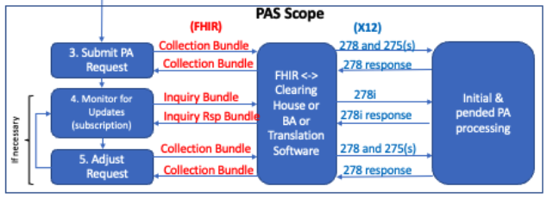
Expected Systems
EHR:
Create the FHIR Bundle that contains the Prior Authorization Request
There are three types of systems that can be involved within PAS…
Intermediary:
Convert between the FHIR Bundle and the X12 transactions and submits to Payer
Payer Service:
Handles the X12 transactions and returns responses

Slide 11
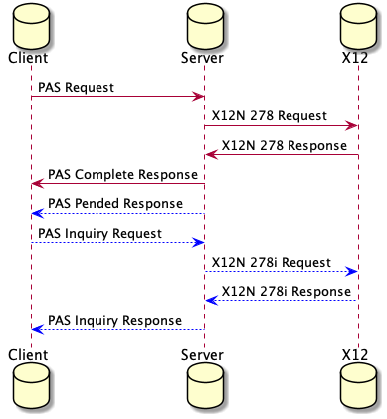
Process Flow Overview

Slide 12
CMS Exception / Enforcement Discretion
CMS approved an exception to a HIPAA requirement that mandated the use of X12 278 transaction when using the PAS FHIR standard. NOTE: This exception ended as of June 2024.
OBRHI National Standards Group announced an enforcement discretion that they would not enforce the requirement to use X12 278 if the covered entities were using the FHIR Prior Authorization API.
When the entities are operating under the enforcement discretion, then no translation of PAS FHIR Bundles into or out of X12 278 transactions is required.
The IG DOES NOT change the requirements for X12 terminology and layouts that match the X12 requirements even for the enforcement discretion.

Slide 13
Submitting a PAS Request
PAS Claim Request
$submit Operation
PAS Claim Response

Slide 14
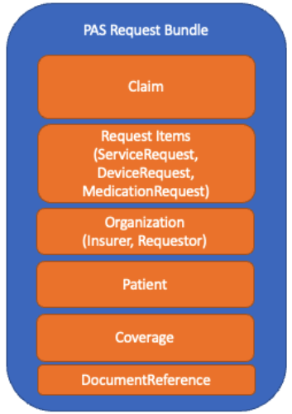
PAS Claim Request
Claim is main FHIR resource
Patient, Organization, Practitioner, PractitionerRole are support resources
ServiceRequest, DeviceRequest, MedicationRequest, etc give more detail about the requested service
Coverage provides insurance information
DocumentReference provides supporting information
https://www.hl7.org/fhir/us/davinci-pas/StructureDefinition-profile-claim.html

Slide 15
$submit operation
The Claim Request Bundle is sent as the sole payload of the Claim/$submit operation.
The intermediary system takes the FHIR Claim Request Bundle and converts it into an X12 278 request and 0..* additional X12 275 transactions and executes them against the payer system.
The payer receives the X12 request, processes it, and sends back a X12 response. The intermediary takes that X12 response and converts it into a FHIR ClaimResponse Bundle.
The response SHOULD be returned within a maximum of 15 seconds.
If a response has not been received from the payer within the 15 second timeframe, a response with PENDED should be returned.
If the operation could be processed due a bad request, an OperationOutcome resource will be returned.

Slide 16
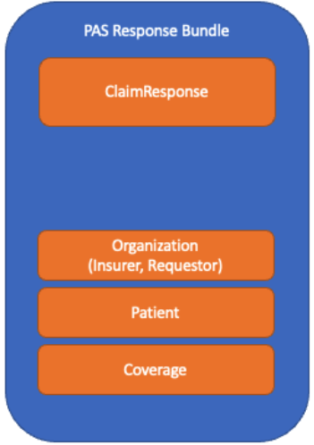
PAS Claim Response
ClaimResponse is main FHIR resource
Patient, Organization, Practitioner, PractitionerRole are support resources
CommunicationRequest provides indication that more information are needed
https://www.hl7.org/fhir/us/davinci-pas/StructureDefinition-profile-claimresponse.html

Slide 17
Different Authorized Items
Often what is authorized is different from what was requested.
Payers return these in different ways. For consistency, the guide defines a specific way of returning these:
Items that are approved are returned with a status of ‘Approved’
Items that are denied are returned with a stats of ‘Denied’
Items where what is authorized is different are returned with a status of ‘Modified’
The modified authorized item is returned as an addItem with an itemSequence that matches the modified item
New items are returned as addItems

Slide 18
Subscriptions for Pended Responses

Slide 19
Subscriptions for Pended Responses
If an authorization response has ‘pended’ items, then a subscription-based mechanism is used for the provider to be informed of updates to the authorization.
There is one defined PAS Subscription topic. When a subscription is needed to be created, the provider POSTs a new Subscription instance to the Intermediary’s Subscription endpoint.
The Subscription is created at the level of the requesting provider organization.
Once the Subscription has been created, the Intermediary will send a notification whenever a prior authorization has been changed. This could happen when the response is complete but may also occur when items have been updated but the response remains ’pended’.
The Subscriptions for R5 Backport IG has more information.

Slide 20
Request for Additional Information
Interaction with CDex and DTR

Slide 21
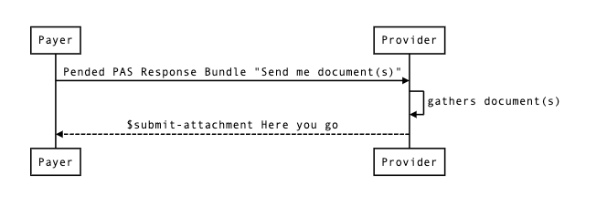
High Level Request for Information

Slide 22
Payer Request for Information
A payer may request additional information. In the X12 278 Response, this could be doing via:
One or more codes in a PWK01 element
One or more LOINC codes from the 2000F HI segment
The single 102089-0 LOINC code in the 2000F HI segment which requests a payer specific questionnaire
If additional information is needed, a PAS Task is created with the request codes. The task contains all of the information needed by CDex to assemble the required documentation and send it to the payer.

Slide 23
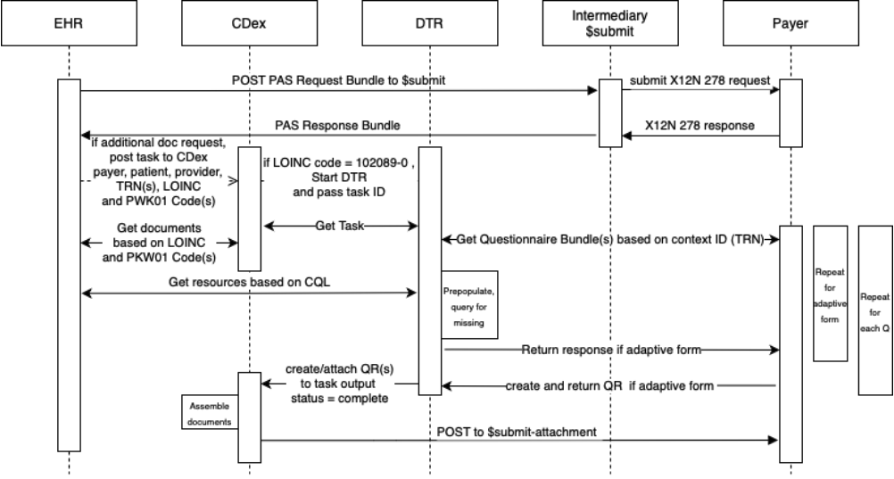
Interaction with CDex

Slide 24
PAS INQUIRIES

Slide 25
$inquire Operation
The inquiry operation is used for systems checking the status of a request. This is normally done by the performing provider who would not get the original response but wants to know if the authorization has happened. It could also be done by the patient, the patient’s caregivers, or other members of the patient’s care team.
The X12 278 Inquiry transaction is performed as a query-by-example. The intermediary converts the PAS Inquiry Request bundle into the X12 278 Inquiry Request transaction and then converts the X12 278 Inquiry Response into the PAS Inquiry Response bundle.
Although the X12 278 Inquiry supports a large way of querying for authorizations, the inquiry operation only supports query for authorizations for a specific patient. The $inquire operation requires a requesting provider organization, a payer organization, and a patient.

Slide 26
PAS Updates

Slide 27
Updating Authorization Requests
Four types of changes possible:
Entire authorization cancelled
Individual items within the request can be cancelled
Individual items can be revised
Additional items and/or supporting information can be added to the request

Slide 28
PAS Inquiry Request Bundle
All items and supporting information are included in the Bundle, including items that have not changed at all.
Any items that are cancelled are flagged with the Item Cancelled modifier extension.
Any items that are added or changed are flagged with the Item Changed extension.
This implies that cancelled items have both the Item Changed extension and the Item Cancelled modifier extension.
All supporting information elements that have been added or changed are also flagged with the Item Changed extension.
The intermediary will look at the extensions to create the appropriate X12 278 and 275 submissions.

Slide 29
Additional Considerations
Expectations for Conformance
Capturing Metrics
Security and Privacy Expectations
PAS and ePA Coordination

Slide 30

Expectations for Conformance
PAS requires conformance to the HRex and US Core guidance where applicable. SHOULD also comply with CRD and DTR
PAS systems will support the $submit and the $inquire operations
PAS systems will support the Subscription requirements of the guide

Slide 31
Capturing Metrics
Collecting metrics facilitates the evaluation of adoption, functionality, and improved outcomes.
Support for the collection of metrics is provided by the PAS Metric Data logical model within the IG.
While PAS does not currently require capturing metrics, the CMS 0057-F rule is requiring it.
START NOW!
Nbr | Metric | Metric Type | Stakeholder | Calculation Example
1 | Volume of PAS submissions (as 278 and line items) | Adoption | Provider / Payer / Intermediary | For 278 volume: PASMetricData.response.exists.count() For service items: PASMetricData.itemDetail.exists.count()
2 | Volume of PAS Updates, Cancels, Queries | Adoption Process | Provider / Payer / Intermediary | For Cancel volume: PASMetricData.exists.where(exchange.type = "cancel").count()
3 | Volume of queries by other than ordering provider | Process | Provider / Payer / Intermediary | For Query volume: PASMetricData.exists.where(exchange.type = "query").count()
4 | % of PAS submissions returning an error (by type and payer) | Process | Provider (all errors) / Payer (subset) / Intermediary (subset) | PASMetricData.where(httResponse != 200).count() For percent: divide volume above by PASMetricData.exists.count() and express as a percentage
5 | % of PAS submissions returning a final result on initial submission (any item and all items) | Process Outcome | Provider / Payer | Number of final : PASMetricData.where(exchange.type = "initial" and itemDetail.result != "pended").count() Divide volume above by: PASMetricData.where(exchange.type = " initial" and itemDetail.exists).count() and express as a percentage
6 | Volume of line items that have an initial PEND and number of PENDS that were resolved and (more complex) average time to resolve each PEND | Process Outcome | Provider / Payer | Number of initial PEND: PASMetricData.where(exchange.type = "initial" and itemDetail.result = "pended").count()
7 | Total time from initial submission until final PA result for all line items | Process | Provider / Payer | PASMetricData.where(ItemDetial.result != "pended") (finalResponseTime - InitialSubmissionTime)
8 | All of the above by payer / provider (depending on metric) and over time | Segmentation | Provider / Payer | Segmentation based on time and PASMetricData.source and (PASMetricData.payerID or PASMetricData.groupID)
9 | Outstanding PAS requests | Operation Dashboard | Provider / Intermediary | PASMetricData.exists.where(itemDetail.result = "pended").count()
10 | Aging of PENDED requests | Operation Dashboard | Provider / Intermediary | for each of the above items (current time - initialSubmissionTime)

Slide 32

Security and Privacy Expectations
General Requirements
Implementers must conform to security/privacy guidance in the FHIR and HRex specifications
(e.g., All data is exchanged over TLS as defined by HRex)
PAS Specific Requirements
Only information necessary to make the prior authorization decision is solicited and/or transmitted

Slide 33

PAS and ePA Coordination
Electronic Prior Authorization Coordinator
Within Burden Reduction payers and providers are the defined monolithic entities…
The reality is there may be multiple systems (and organizations) involved.
Payers and/or providers may develop “electronic prior authorization coordinator” systems to meet PAS requirements.
Currently there are no defined standards for how such components interact with other payer and provider systems.
PAS provides an ‘informative’ view of how this Coordinator may work – no conformance requirements.

Slide 34
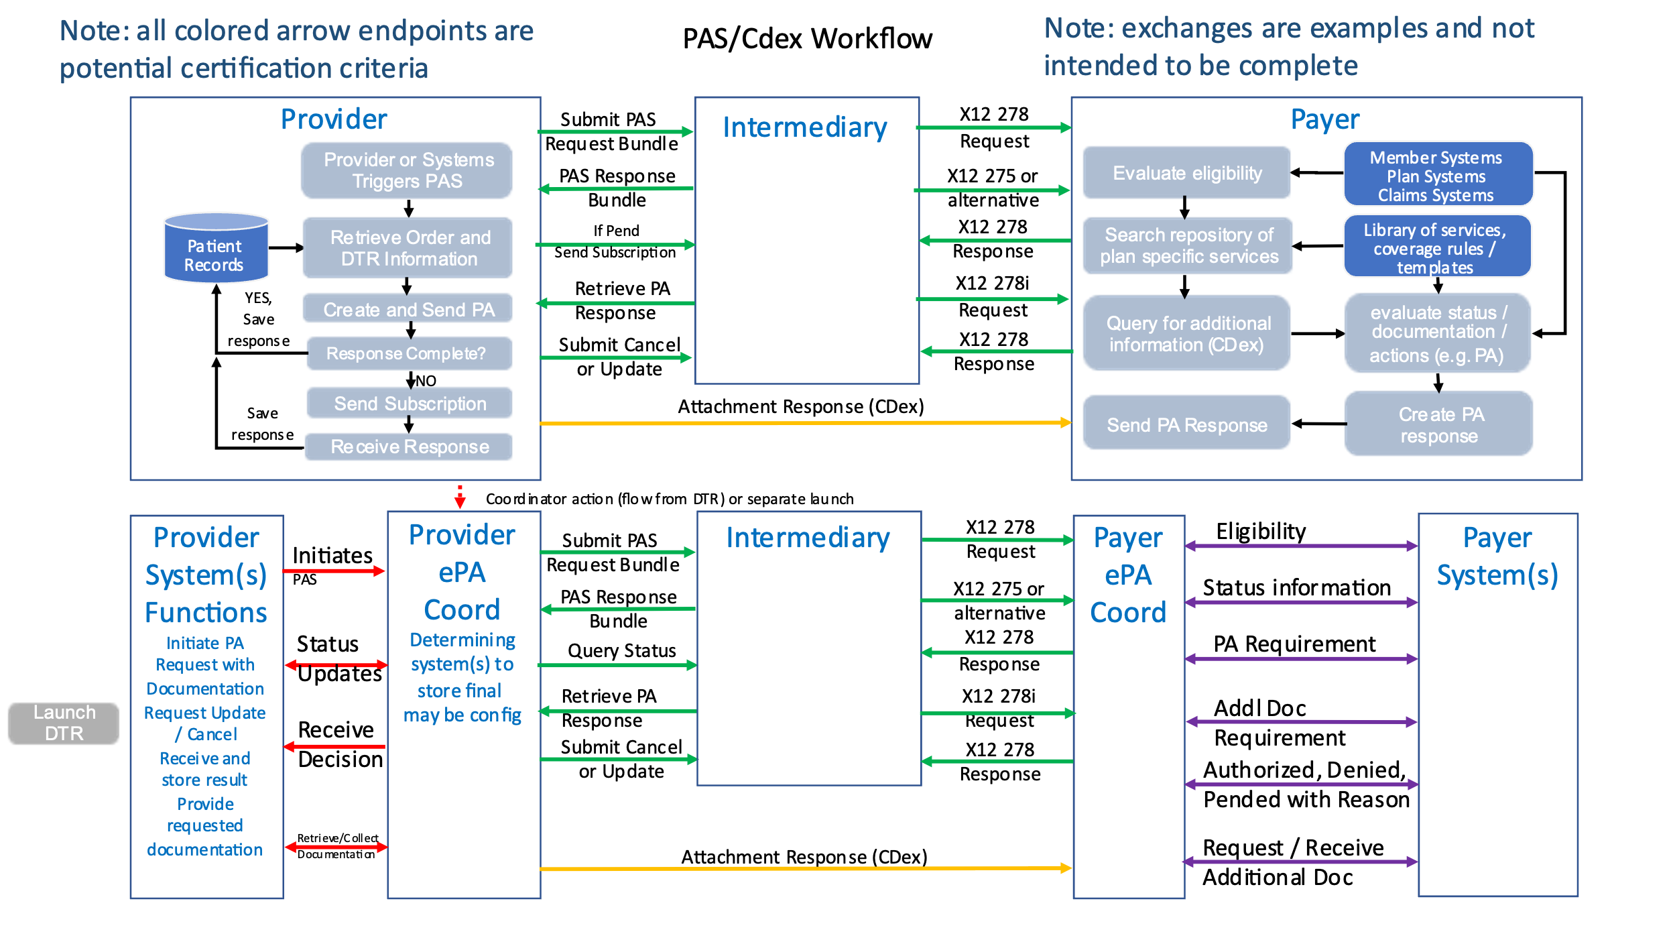

PAS and ePA Coordination
For more details see the ePA page of the PAS Implementation Guide.

Slide 35




Questions / Discussion
Contact me by email at jean.duteau@dogwoodhealthconsulting.com
Or, better yet, include the community and ask/discuss on Zulip
https://chat.fhir.org/#narrow/channel/208874-Da-Vinci-PAS

